Slide 1


Slide 2
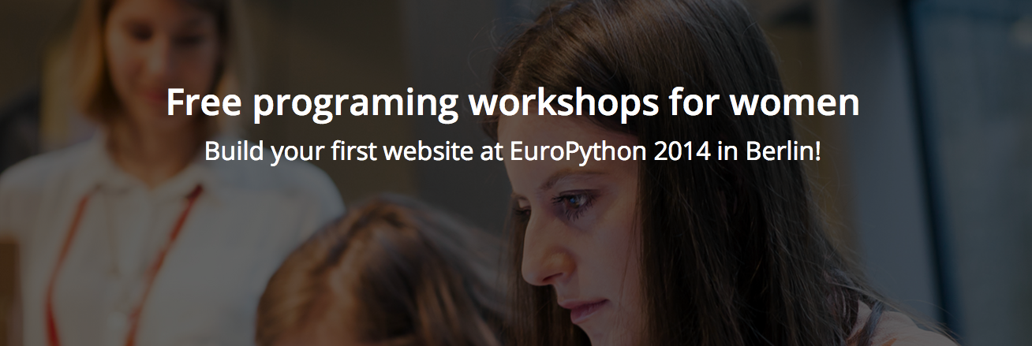

Slide 3
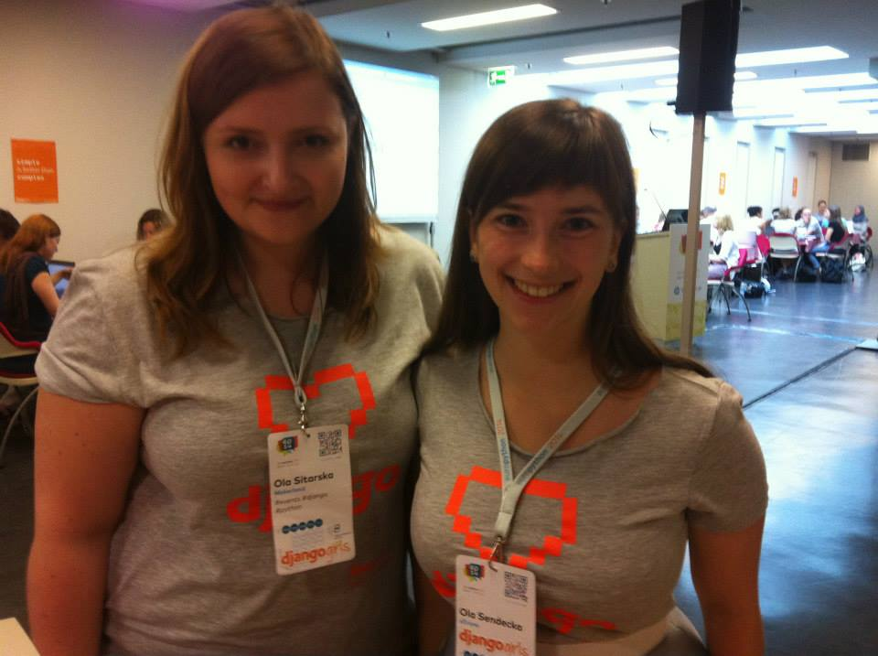
Ola Sitarska
&
Ola Sendecka

Slide 4
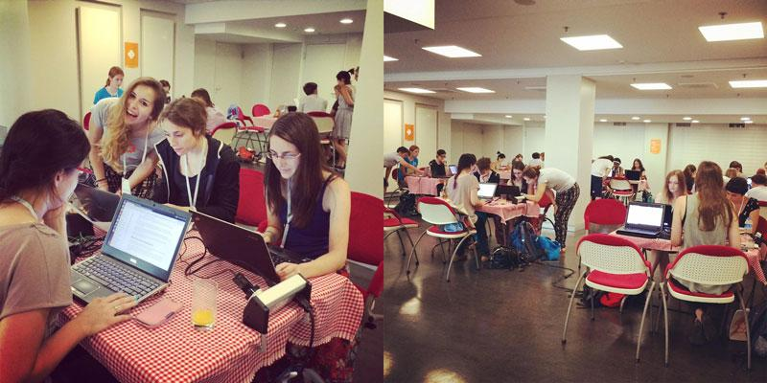

Slide 5
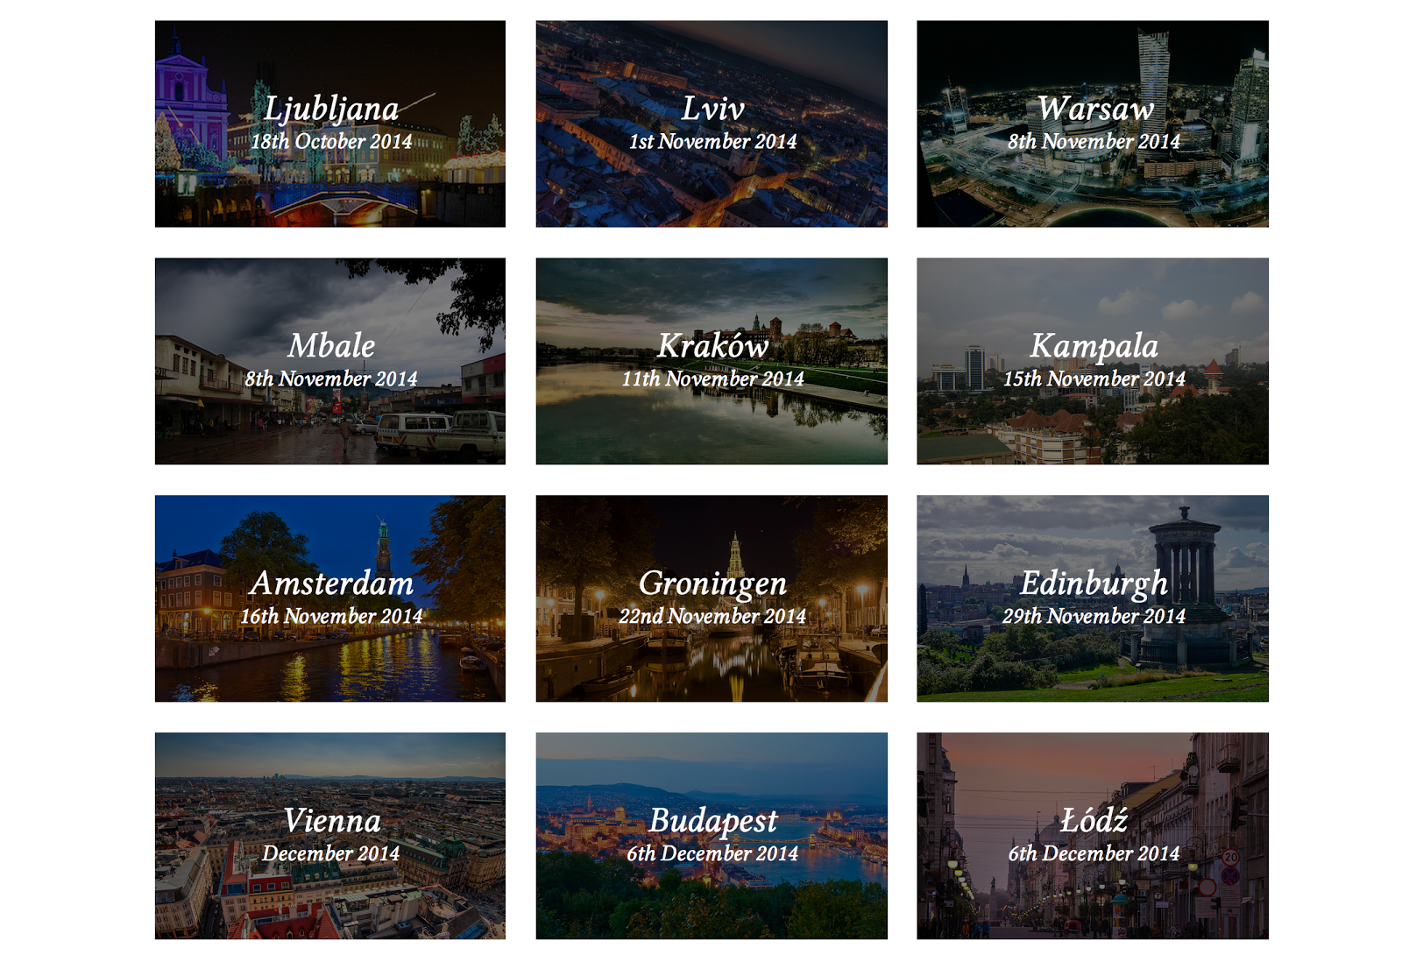
Upcoming events

Slide 6


Slide 7
tutorial.djangogirls.org

Slide 8
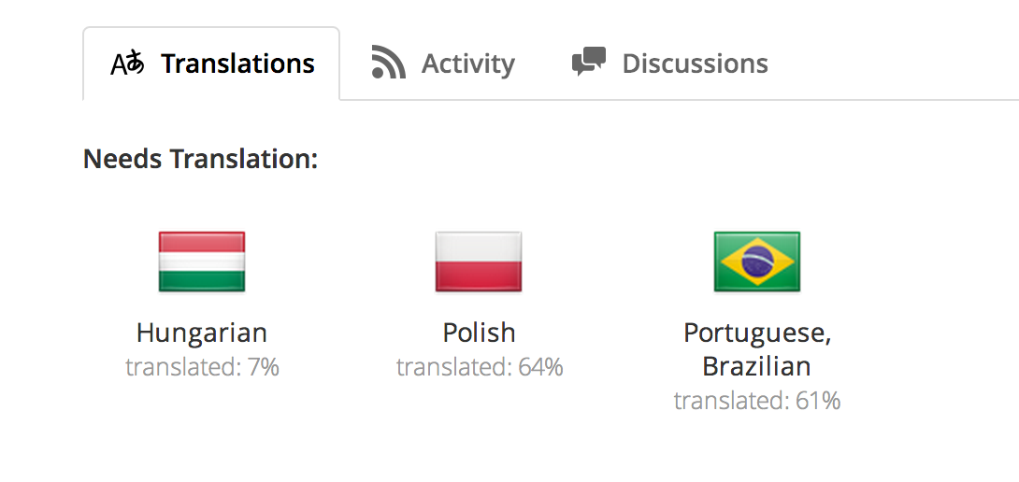
translate.djangogirls.org

Slide 9
start your own event!

Slide 10
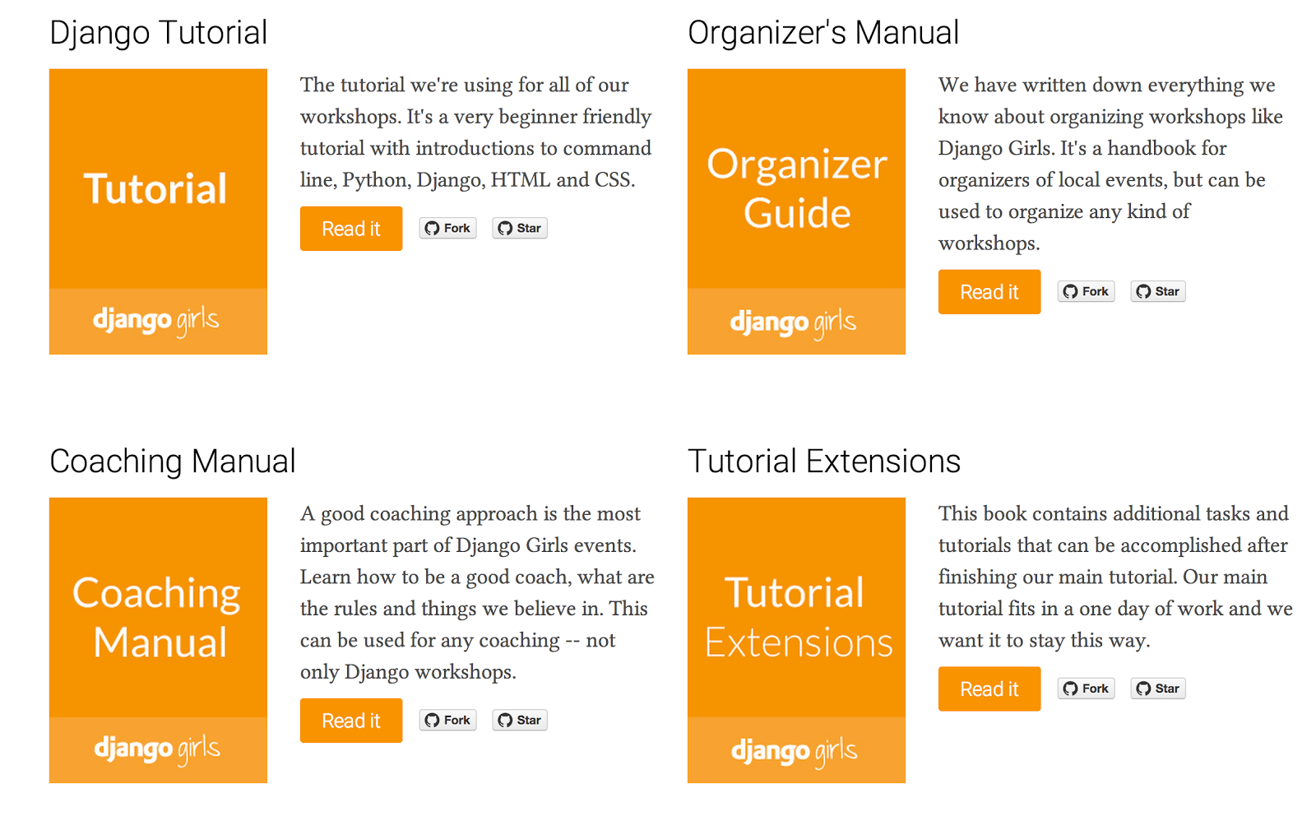

Slide 11
djangogirls.org

